Slide 1
North Carolina Housing Supply and Demand
Population count alone is not a sufficient proxy for demand

Slide 2
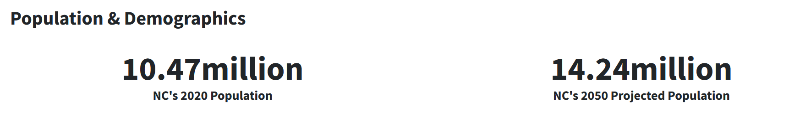
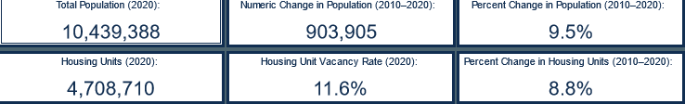
North Carolina is Growing Quickly
Notes:
North Carolina consistently ranks as one of the fastest growing states in the U.S. Population from 2010 to 2020 increased by 9.5% to over 10 million people. During that time, housing units increased by 8.8%. By 2050, North Carolina’s population is projected to grow to over 14 million people. There has been a consistent lag of housing units, which is emblematic of general housing shortage in the U.S.

Slide 3
Town and city planners try to address the need for a balance of higher-end housing and affordable housing through zoning and land-use plan …
But it often takes a significant amount of time for prospective residential developments to pass through the zoning process, in some cases contributing to housing supply limitations.
… one of the key concepts of real estate analysis – the prediction of housing prices … the supervised ML methods provide a comprehensive description of the determinants of owner-occupied housing values in the census tracts ... regressions provide relatively better out-of-sample predictions … the benefits of shrinkage-based ML methods are their ability to resolve such issues as variable selection and overfitting.

Slide 4
A Look at the Data
## Zip State Municipality Metro ## Min. :27006 Length:8640 Length:8640 Length:8640 ## 1st Qu.:27605 Class :character Class :character Class :character ## Median :28102 Mode :character Mode :character Mode :character ## Mean :28058 ## 3rd Qu.:28517 ## Max. :28909 ## County Year Value Population ## Length:8640 Min. :2011 Min. : 0 Min. : 37 ## Class :character 1st Qu.:2014 1st Qu.: 106016 1st Qu.: 2613 ## Mode :character Median :2016 Median : 151580 Median : 7292 ## Mean :2016 Mean : 172896 Mean :13760 ## 3rd Qu.:2019 3rd Qu.: 220052 3rd Qu.:20752 ## Max. :2022 Max. :1796977 Max. :81219
Notes:
The data was collected for 2011 through 2022. The population figures ranged from 37 in a zip code to 81,219. This exemplifies the challenge with this project – to accurately model such disparate figures.

Slide 5
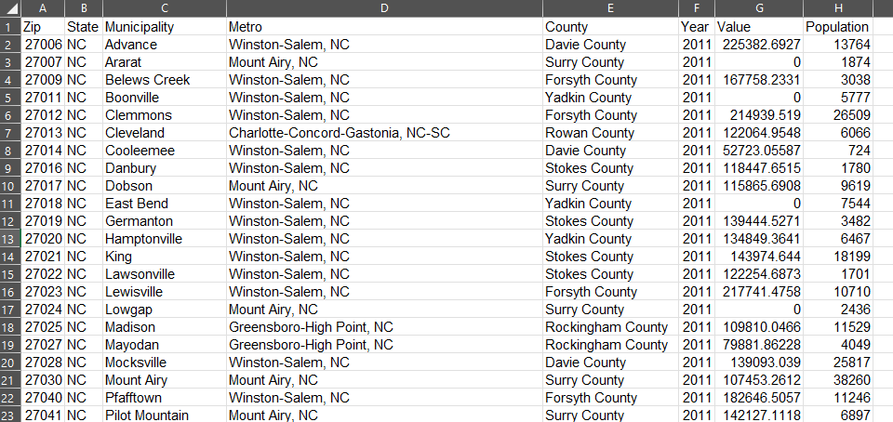

Slide 6
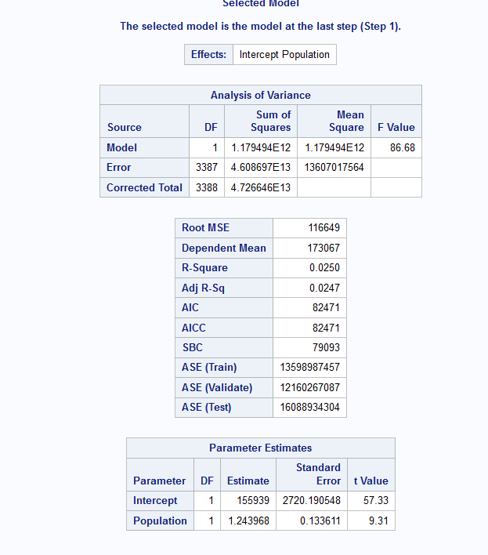
Notes:
The population parameter t Value is 9.31 and this is above the critical value so the model does not predict values with enough confidence. Therefore, we fail to reject the Null hypothesis.

Slide 7
Conclusion
This model does not use population to forecast housing prices to a statistically significant degree.
Recommendations
Properly account for other factors of housing demand such as prevailing interest rates at time of measurement of data, and/or to adjust for demographic shifts, such as more younger folds with babies or older folks looking to retire.

Slide 8
References
Amend, P., et al. (2019). IDENTIFYING AND ADDRESSING LOCAL AFFORDABLE HOUSING CHALLENGES IN NORTH CAROLINA. Carolina Planning Journal, 44, 12-23.
E. Simlai, P. (2021). Predicting owner-occupied housing values using machine learning: An empirical investigation of California census tracts data. Journal of Property Research, 38(4), 305-336. https://doi.org/10.1080/09599916.2021.1890187
Mu, J., Wu, F., & Zhang, A. (2014). Housing value forecasting based on machine learning methods. Abstract and Applied Analysis, 2014, 1-7. https://doi.org/10.1155/2014/648047
NC OSBM: About OSBM. (n.d.). NC OSBM. https://www.osbm.nc.gov/about-osbm
Swanson, D. A., & Hough, G. C. (2012). An evaluation of persons per household (PPH) estimates generated by the American community survey: A demographic perspective. Population Research and Policy Review, 31(2), 235-266. https://doi.org/10.1007/s11113-012-9227-8
US Census Bureau. (2023, August 10). ZIP code tabulation areas (ZCTAs). Census.gov. https://www.census.gov/programs-surveys/geography/guidance/geo-areas/zctas.html

